Slide 1
From Documents to Knowledge Practical Knowledge Management in Scientific Domains Jon Stephens, Computational and Data Researcher University Summer Institute 2025

Slide 2
Goals of Today’s Session
01. Introduce the fundamentals of Knowledge Management (KM)
03. Explore ontologies, semantic relationships, and knowledge graphs
02. Understand its role in science and research

Slide 3
What is Knowledge Management (KM)?
KM is the process of capturing, organizing, sharing, and effectively using knowledge.
From unstructured data → structured knowledge
Increases accessibility, usability, and value of research
Example: Moving beyond PDF files to reusable, searchable knowledge

Slide 4
Why Knowledge Management Matters
Today’s science is data-rich but insight-poor.
Knowledge ≠ Data: Knowledge is curated, contextualized, and actionable.
KM helps ensure that:
Discoveries are not lost.
Research is reproducible.
Institutional memory persists.
Quote: “If only we knew what we know.” – Peter Drucker

Slide 5
Knowledge Management Lifecycle:
5 Key Phases:
Create – Generating new knowledge (experiments, insights)
Capture – Storing knowledge (notebooks, scripts)
Organize – Classifying, structuring (ontologies, metadata)
Share – Disseminating across teams/institutions
Apply – Using knowledge for decisions, designs, and new research

Slide 6
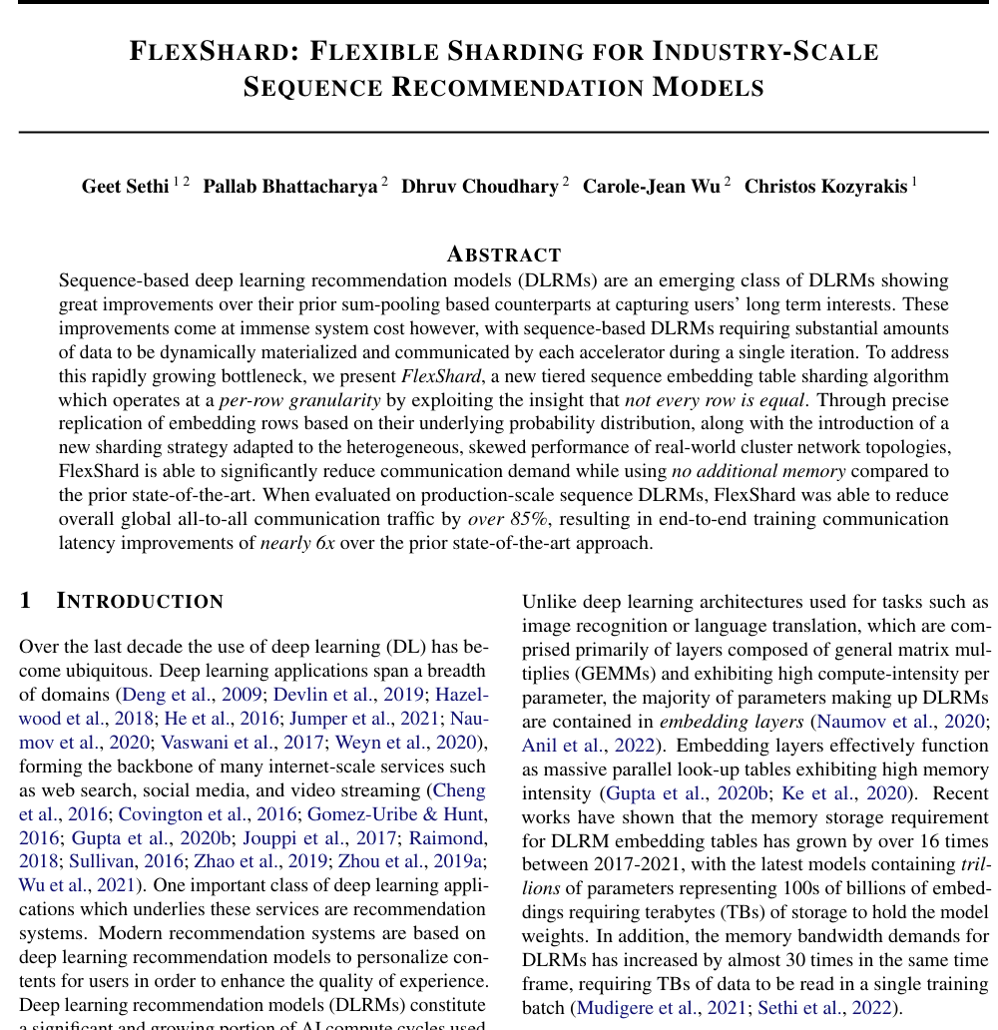
Metadata
NLP
Procesor
PolyStore
(DB + KG)
Entities
Relationships

Slide 7
Why Knowledge Management Matters in Science
Scientific literature is exploding in volume
Redundancy and lost insights are common
KM enables:
Efficient literature reviews
Research collaboration
Semantic search and synthesis

Slide 8
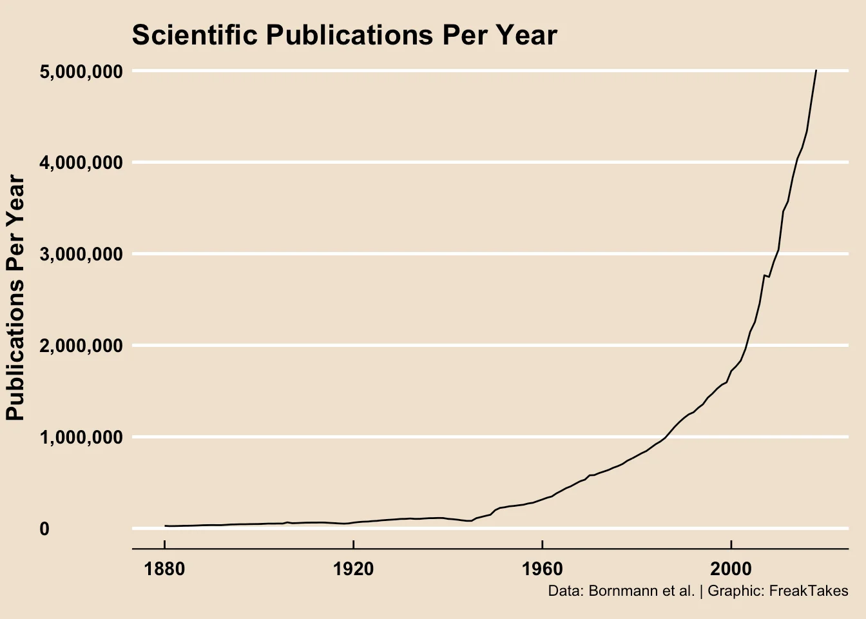
Find the needle…

Slide 9
Tools for Knowledge Management
Tools & Technologies for Scientific KM
Ontologies (e.g., Gene Ontology, OBO Foundry)
Knowledge Graphs (e.g., Neo4j, Wikidata, SciGraph)
Semantic Search Engines (e.g., Solr, Elasticsearch)
Version Control (Git/DVC for code and data)
AI-enhanced KM: LLMs for summarization, auto-tagging, semantic query

Slide 10
Ontologies
Ontologies are structured vocabularies that define concepts and relationships in a domain.
They provide semantic consistency, enabling integration, annotation, and reasoning over scientific data.
Example: Gene Ontology helps standardize how biological functions are described across species and databases. (e.g., Gene Ontology, OBO Foundry)
Visual Example

Slide 11
Ontologies: From Concepts to Hierarchies
Ontology: A formal structure to define classes, relationships, and properties
Example: Chemical → Molecule → Alcohol → Ethanol
Allows reasoning, validation, inference

Slide 12
Note on Ontologies:
They are curated, usually manually, by the effort of many people over a long period of time. They are not easily scalable. But with the advent of LLMs the knowledge curation process is becoming faster if more error prone.

Slide 13
Knowledge Graphs
Knowledge graphs represent entities (e.g., proteins, authors, datasets) and their relationships as a network.
They enable semantic queries, linking across disciplines, and discovery of hidden connections.
Example: SciGraph connects scientific publications, datasets, and researchers into an explorable graph. (Neo4j, Wikidata, SciGraph)

Slide 14
Semantic Search Engines
These systems go beyond keyword matching to support metadata-aware, faceted, and ontology-driven search.
They’re essential for navigating large corpora of scientific data or documents with meaningful context.
Example: Searching “cancer immunotherapy” can return papers tagged under related immune pathways. (e.g., Solr, Elasticsearch)

Slide 15
Version Control
Version control systems track changes in code, scripts, or datasets over time.
They support reproducibility, collaboration, and rollback — crucial for evolving research workflows. Example: Git for code, and DVC for tracking ML training datasets or experiment results. (Git/DVC for code and data)

Slide 16
AI-enhanced KM
AI tools like large language models (LLMs) can automatically extract knowledge, summarize documents, and generate semantic tags.
They reduce manual KM effort and enable natural language interaction with structured knowledge. Example: An LLM-powered assistant summarizes a set of papers into hypotheses or answers natural language questions using a knowledge base. (LLMs for summarization, auto-tagging, semantic query, semantic enrichment, etc.)

Slide 17
The Machine Learning Paradigm Shift
Traditional ML relies on large labeled datasets
Increasing need to inject knowledge (e.g., ontologies, graphs) into models
KM provides the structured context ML models need to provide the most comprehensive and correct responses to user queries. (This is especially relevant with respect to domain specific questions where pretrained models do not have the domain knowledge to answer said questions.)

Slide 18
Example Knowledge Pipeline

Slide 19
From Documents to Structured Knowledge
Example Pipeline Stages:
Document ingestion, Parsing, and NLP
Metadata and entity extraction
Semantic enrichment
Indexing and storage (Create Ontology, Solr Index, Tabular Datastore, Knowledge Graph, etc.)

Slide 20
Ingesting and Parsing Documents
Select one scientific article (PDF or text)
Run Custom (or Standard) Parser
Output structured data (e.g. Metadata, Extracted Terms, Chunked Text, etc.)

Slide 21
Semantic Search and Retrieval
Use Solr/Elasticsearch for indexing
Query terms and semantic similarity
Optional: Custom UI or terminal-based demo

Slide 22
Building a Knowledge Graph
Entities as nodes (authors, papers, concepts)
Relations as edges (writes, cites, defines)
Enables discovery of hidden patterns

Slide 23
Knowledge Graph in Action
Use Graph Visualizer to Explore Graph

Slide 24
Infrastructure Behind It All
Dockerized setup: Postgres, Solr, Redis, NLP tools
Multithreading for high throughput
Distributed computing for scale

Slide 25
Infrastructure Snapshot
Dockerized Containers run all services. (Use “docker-compose up” to initialize infrastructure for easier maintenance.)
Run docker containers for Postgres, Neo4j, Solr, etc.

Slide 26
Final Thoughts
KM is a critical, enabling layer for modern research
Combining domain knowledge + technology = powerful insights
Encouragement to start small with ontologies and document tagging

Slide 27
Questions?

Slide 28
Thank you
Company Name
Quarter
Month Year

